Slide 1

FLIGHTDOM
BY M.SAI GOWTHAM REDDY
M. REDDY KIRAN
C.RAMAKRISHNA

Slide 2
CRUD Operations
Create:
Book a seat: Initiate a new flight booking.
Read:
Check PNR: Retrieve booking details using the PNR number.
Update:
Future: Implement booking modification features.
Delete:
Cancel Booking: Remove an existing booking from the system

Slide 3
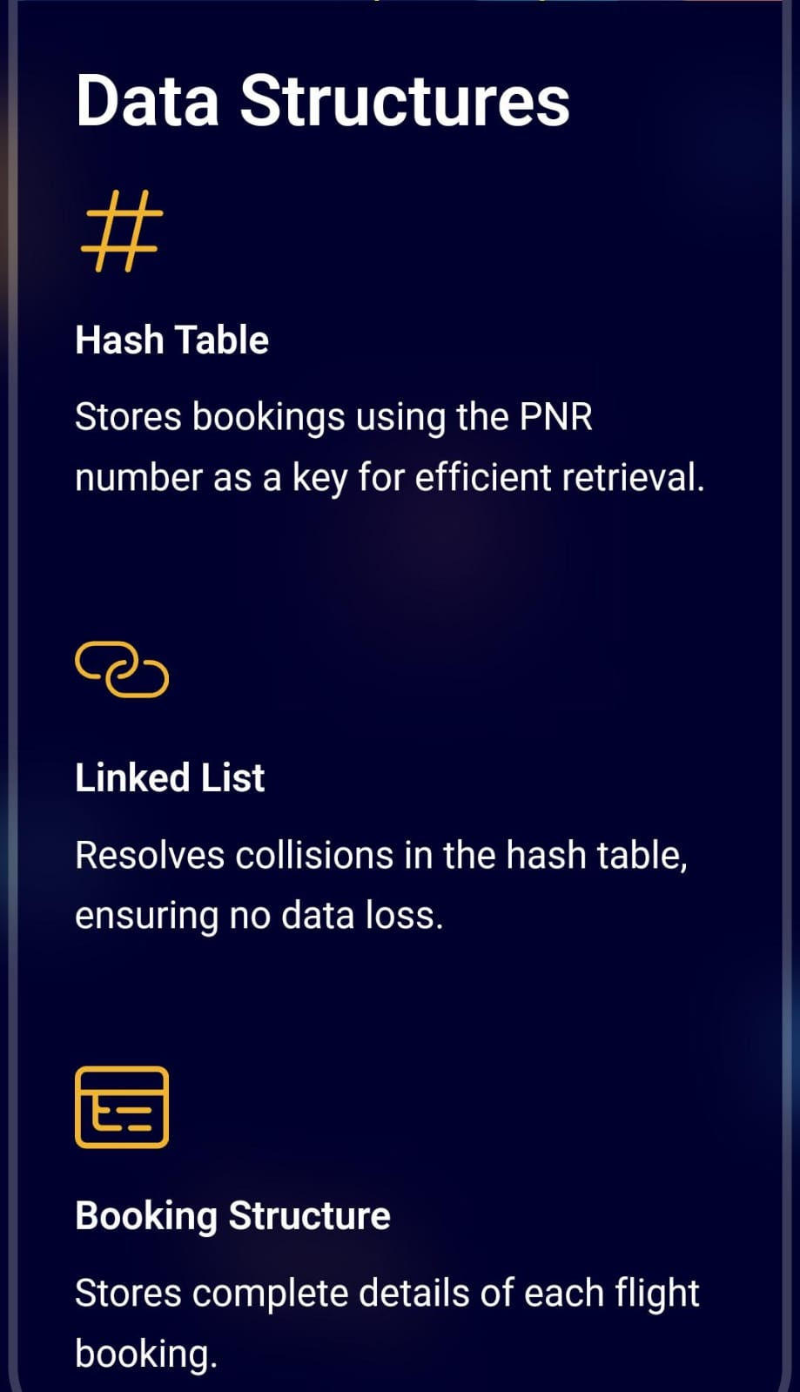
HASH TABLE:

Slide 4
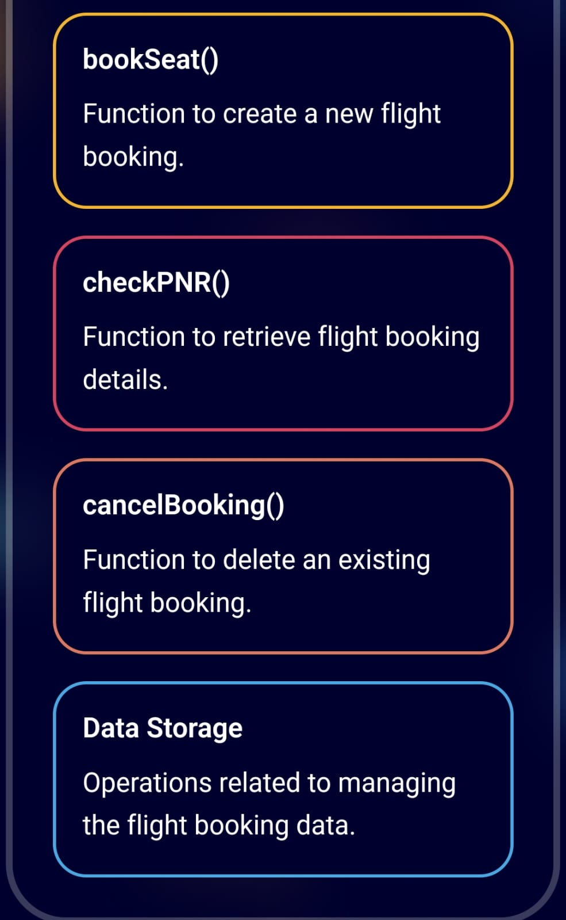
fUNCTIONALITY

Slide 5
CONCLUSION:
This presentation highlighted FLIGHTDOM, emphasizing key functionalities, including CRUD operations for seamless airline booking management. With structured booking, retrieval, updates, and cancellations, this system enhances efficiency and customer experience. Ensuring accuracy and innovation, it contributes to a reliable and user-friendly airline service.
THANKYOU

